Slide 1

SUPPLY CHAIN
ANALYTICS
Group 10
- Yash Deshpande
- Siddhant Dhatrak
- Anuj Gopanwar
- Sacchit Shah

Slide 2





MAIN OBJECTIVE
01
Which country contributes to the highest number of fraud orders, and which category are these orders from?
02
Which category of the product has the most pending orders
03
What is the impact of delivery status on the orders?
04
What is the preferred shipping mode among customers

Slide 3
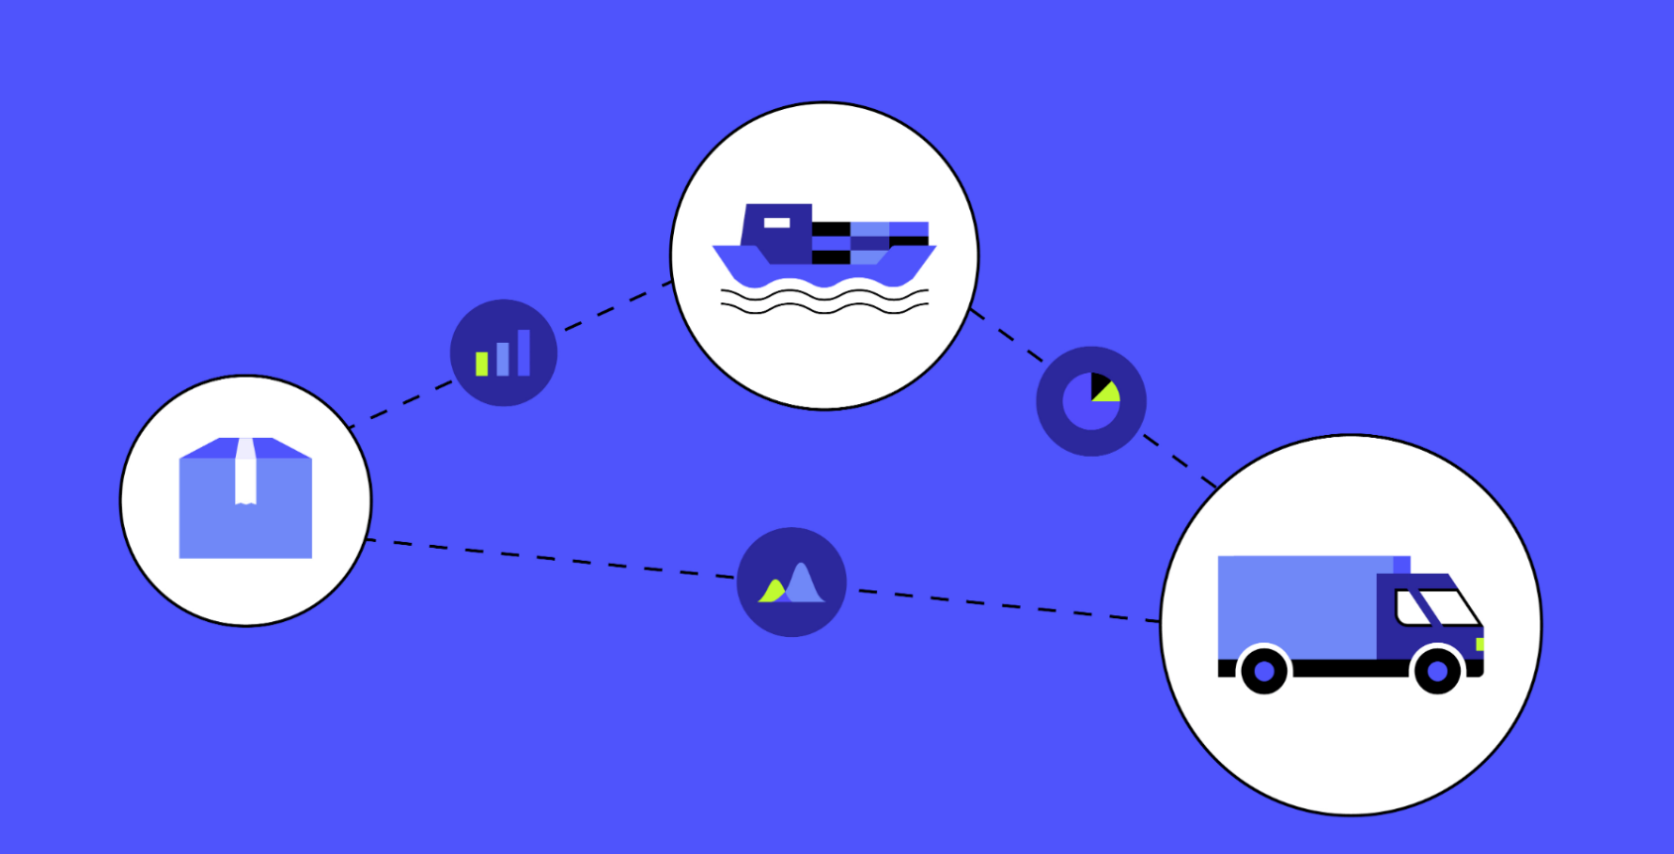
HYPOTHESIS
01
The top 10 profitable products in the United States are all in the outdoors and fitness.
02
The percentage of orders that are pending payment is higher than the percentage of orders that are on hold.
03
Delivery status can impact supply chain with inventory, production, cost, and customer satisfaction issues

Slide 4
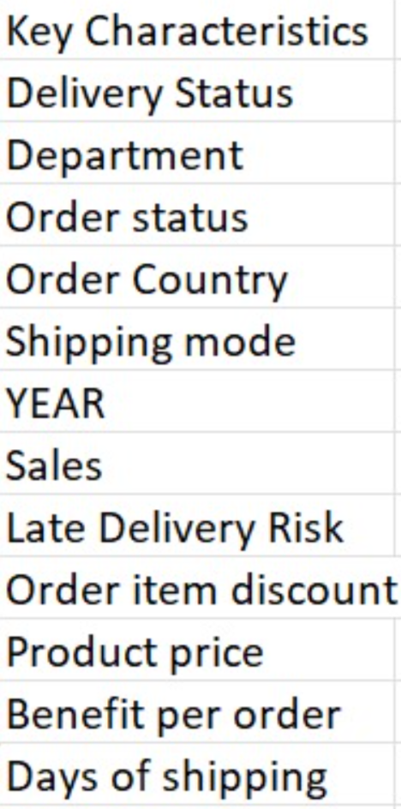




DATASET
DATA
DATA SOURCE
180k Rows
53 Cloumns
Open Source: Kaggle

Slide 5

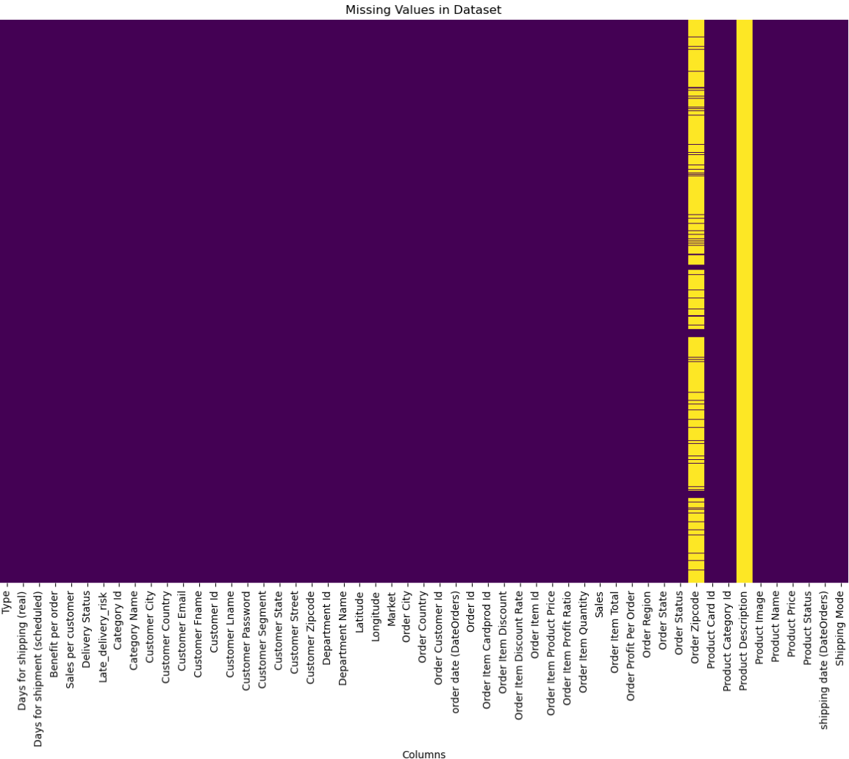
DATA
CLEANING
Zipcode & Product Description has more than 80% of missing values.
These columns are removed.

Slide 6
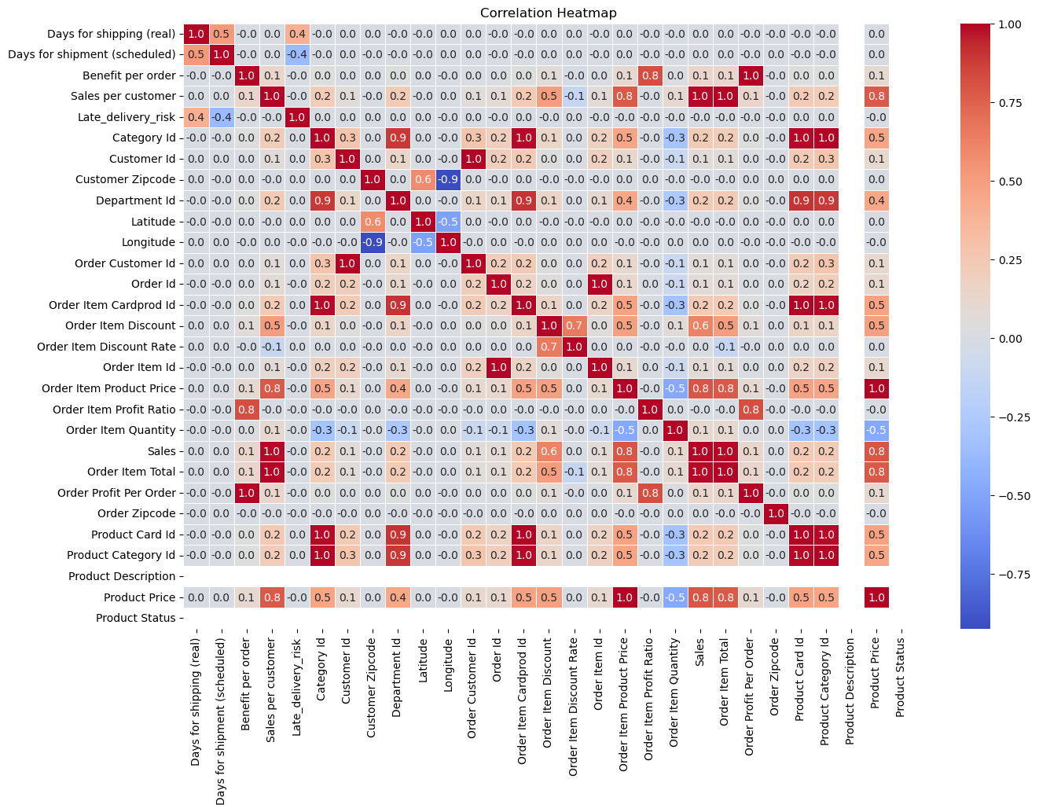
DATA
CLEANING
Red indicates there is a strong positive correlation between the variables.
Variables with strong relationships which are further used for analysis and decision-making.

Slide 7
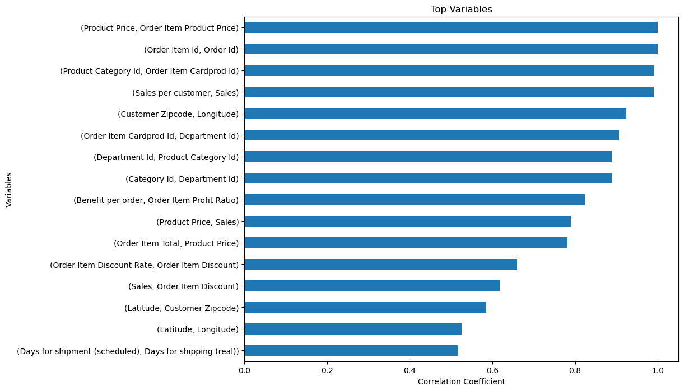
FEATURE
SELECTION
Variables with correlation more than 0.5 are selected because there were still 34 variables after correlation
Top 19 Variables were selected finally

Slide 8
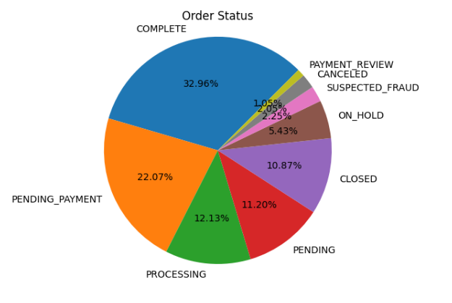
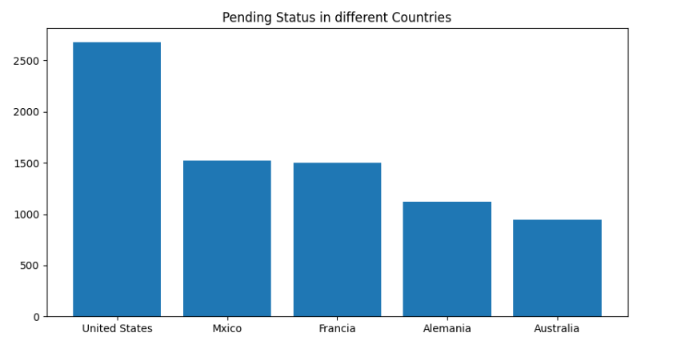
PENDING ORDER ANALYSIS
Pending orders constitute 11.20% of the total order status
The United States has the highest share of pending orders among all countries
Pending orders are an important metric to track and manage, as they can impact customer satisfaction and revenue

Slide 9
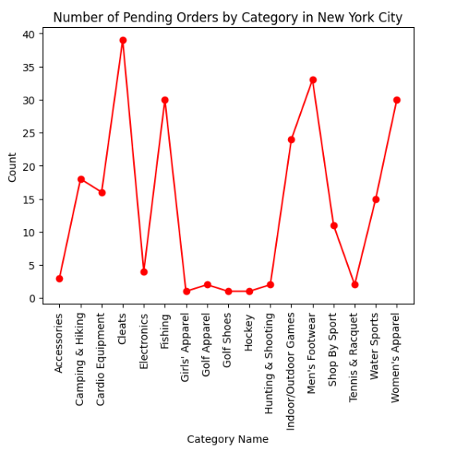
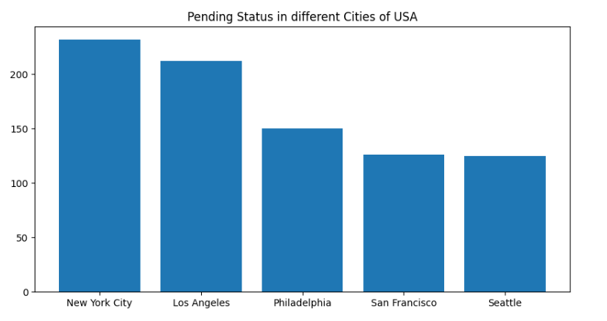
PENDING ORDER ANALYSIS
New York City (NYC) has the highest percentage of pending orders among all cities in the United States.
In NYC, the "cleats" category has the most pending orders.
Pending orders can impact customer satisfaction and revenue, so it's important to address them promptly and effectively.

Slide 10
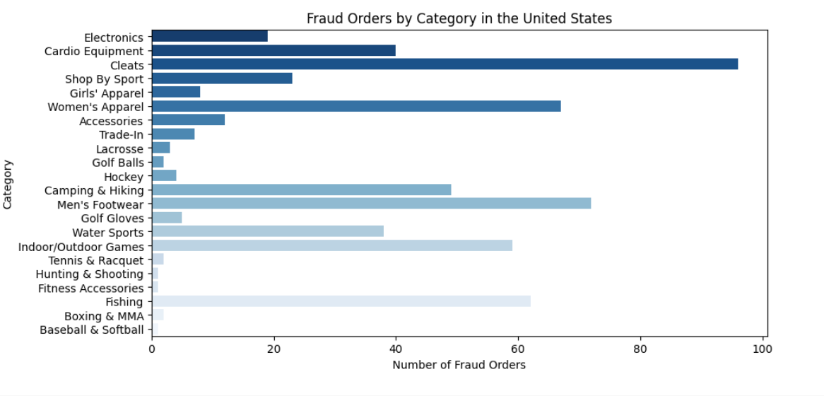
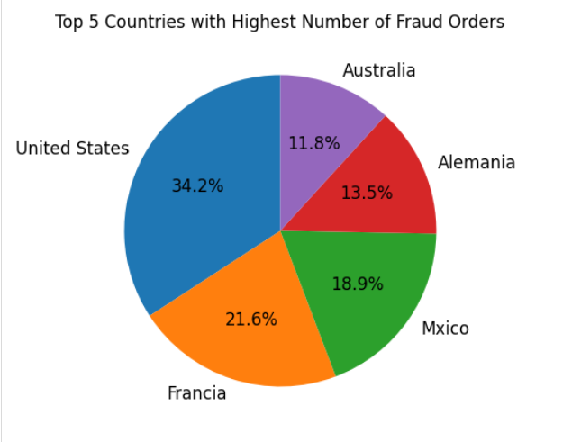
FRAUD ORDER
ANALYSIS
Most fraud cases occur in the USA
Category wise frauds happen in cleats followed by men’s footwear and women’s apparel

Slide 11
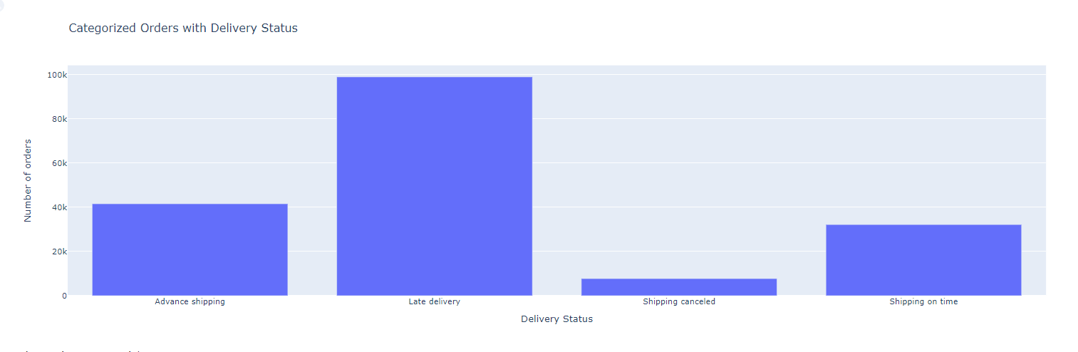
ORDER DELIVERY ANALYSIS
Researched on Delivery status in different regions
Late delivery is causing disruption in supply chain of the company for around 98.977K orders

Slide 12
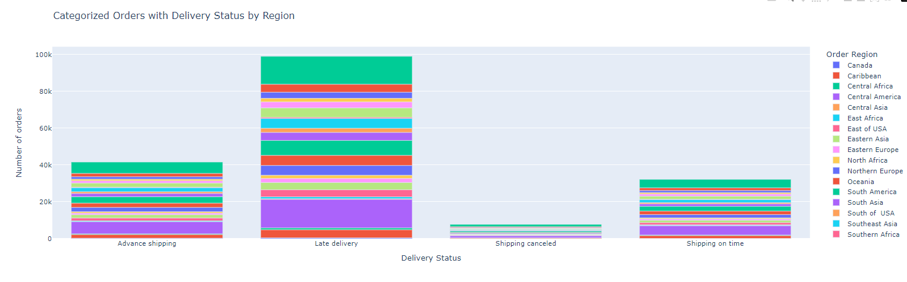
ORDER DELIVERY ANALYSIS
Most orders are from Western Europe and Central America
We will suggest the team to focus on the issues in these regions.

Slide 13
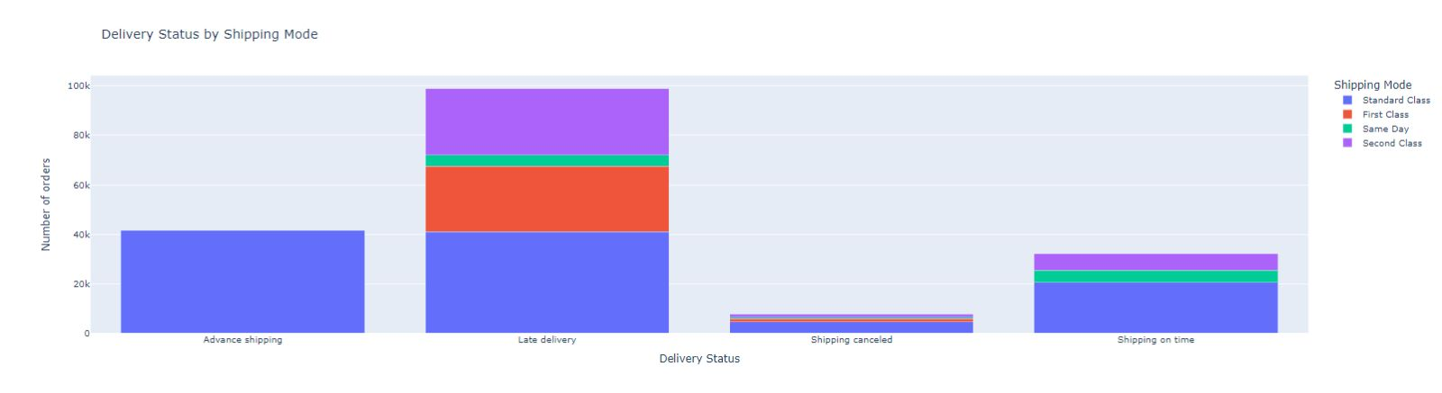

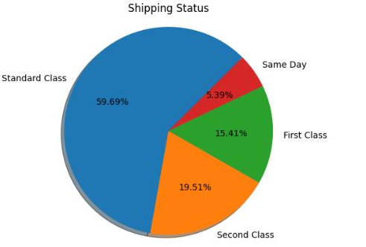
SHIPPING MODE ANALYSIS
The Challenge of Timely Delivery: Late Delivery Rates at 40%
First Class Shipping: An Alarming Late Delivery Rate of Nearly 50%
Navigating Late Delivery Challenges: Strategies for Improvement

Slide 14

INSIGHTS
Focus on late deliveries, particularly in Western Europe and Central America.
Shipping mode performance impacts supply chain aspects like cost, speed, reliability, and sustainability, affecting the company's bottom line and customer satisfaction
Focusing on pending orders can prevent supply chain disruptions, production schedule adjustments, increased costs
Customers favor low-cost options like Standard Class over Same Day shipping.

Slide 15

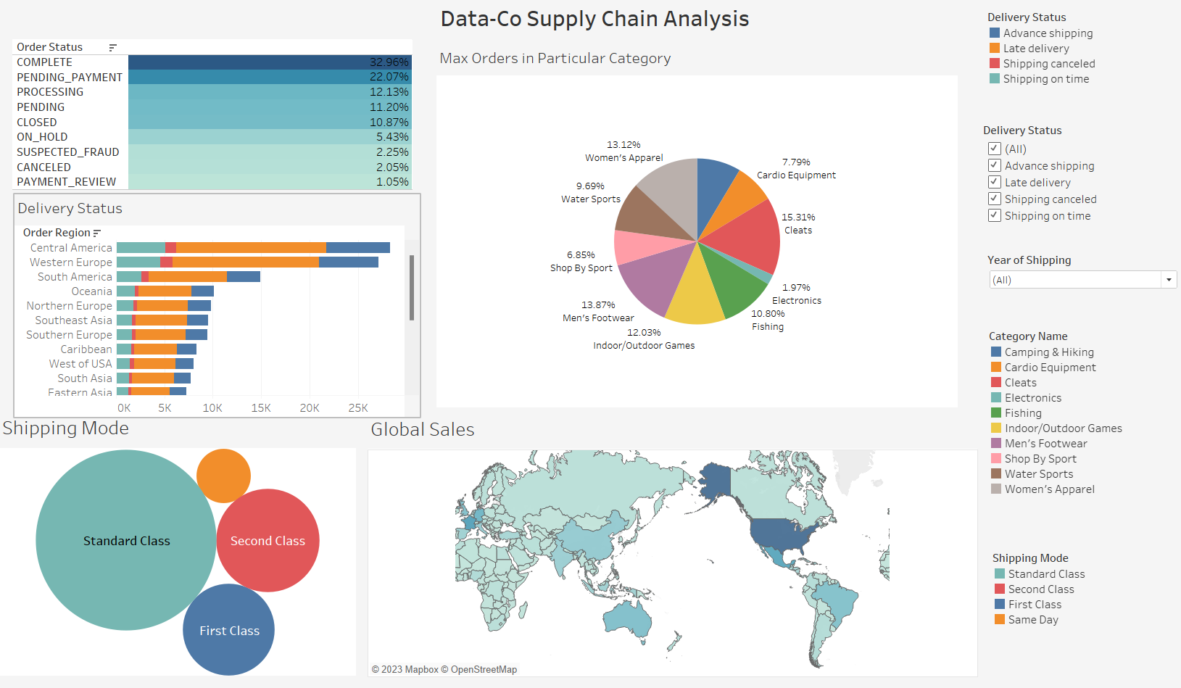
DASHBOARD

Slide 16
Thank You

